Slide 1
LA City Homeless
An exploratory analysis
Group 16
Jue Song
Zhuoqun SHENG
Xudong ZHANG

Slide 2
Content
Data Analysis & Visualization
Next Step
Crime Statistics
Shelter Functionality
311 Call Response Time

Slide 3
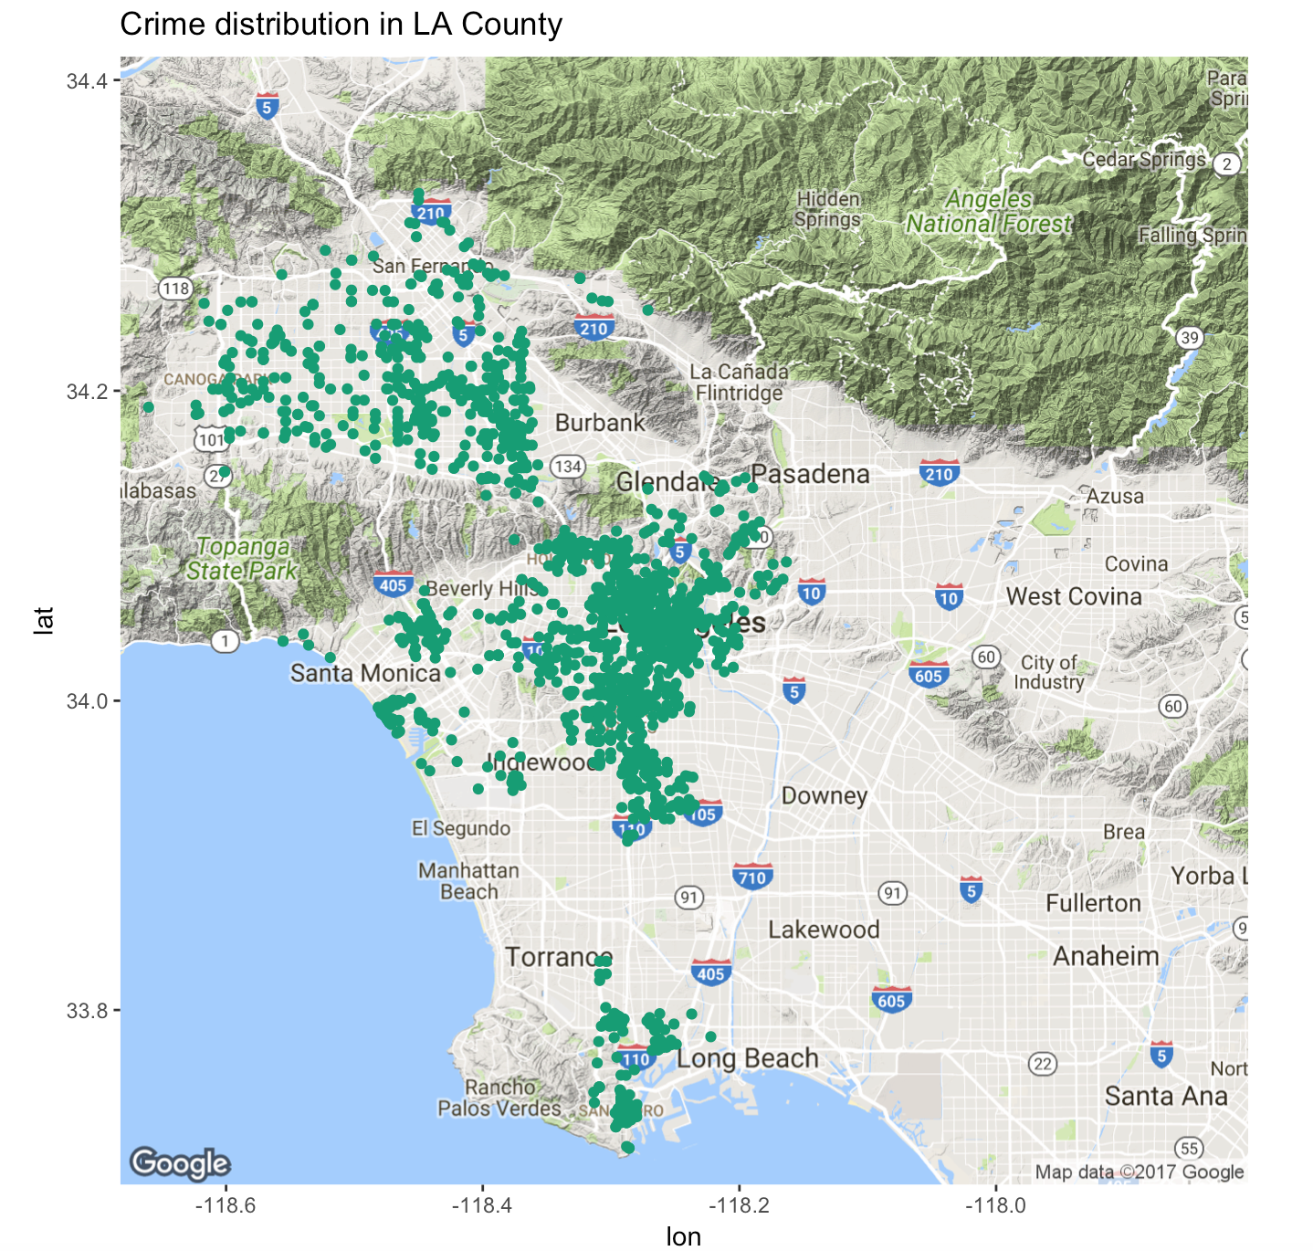
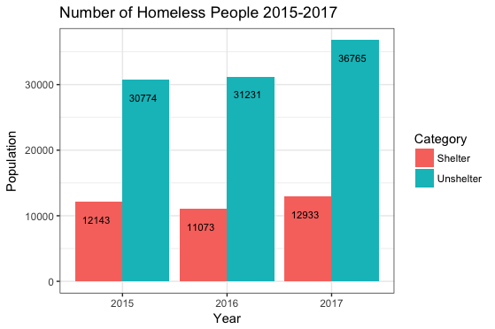
Overall Trend
Notes:
as we can see from the bar chart, from 2015-2017, the total number of homeless people has been increasing. in the meantime, the proportion of unsheltered people has also increased, reaching over 70% of the total homeless population.

Slide 4
Part 1 – Crime Statistics

Slide 5
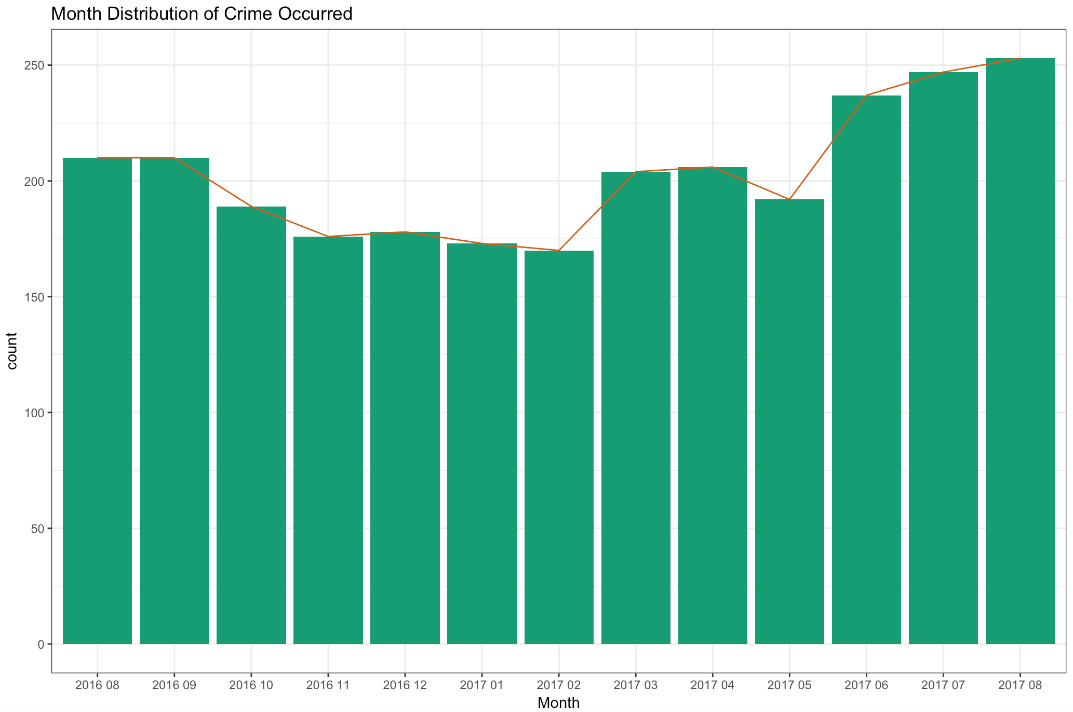
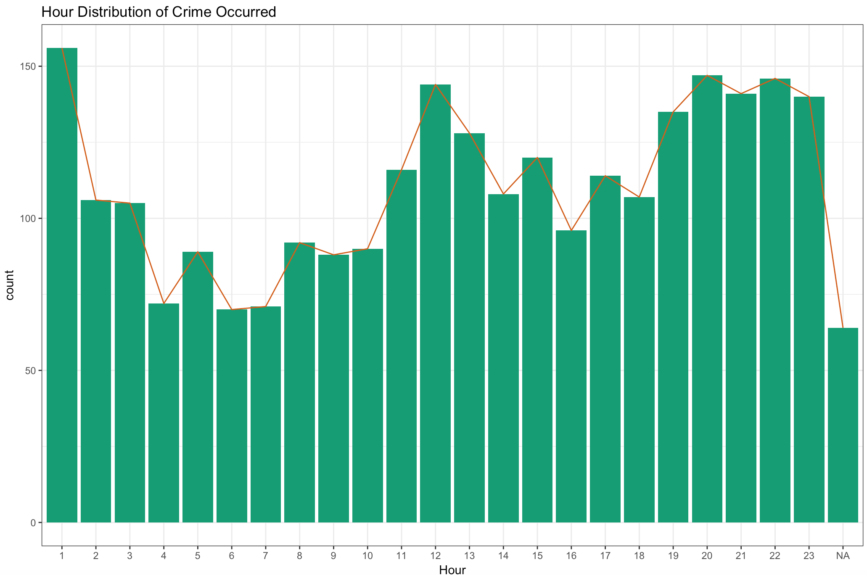
Time
Peak Month: August Peak Time: Noon & Night
Notes:
First, we look into the time of the crime occurred based on a monthly basis and hourly basis. We found that August has the highest number of crimes, and most of the crime occurred at noon and at night, the peak hours are 12pm and 8pm-1am.
August present an extreme value, we are going to take a deeper at look this month, such as finding crime category happened in this month to get more insights
白天的案件 晚上的案件 哪个区域容易发生哪种案件

Slide 6
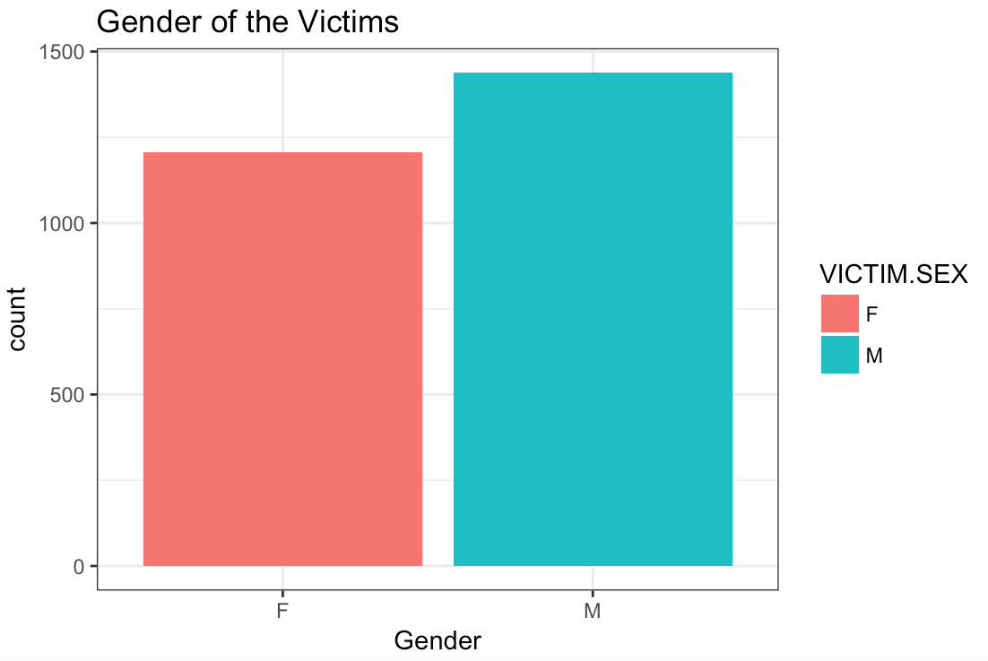
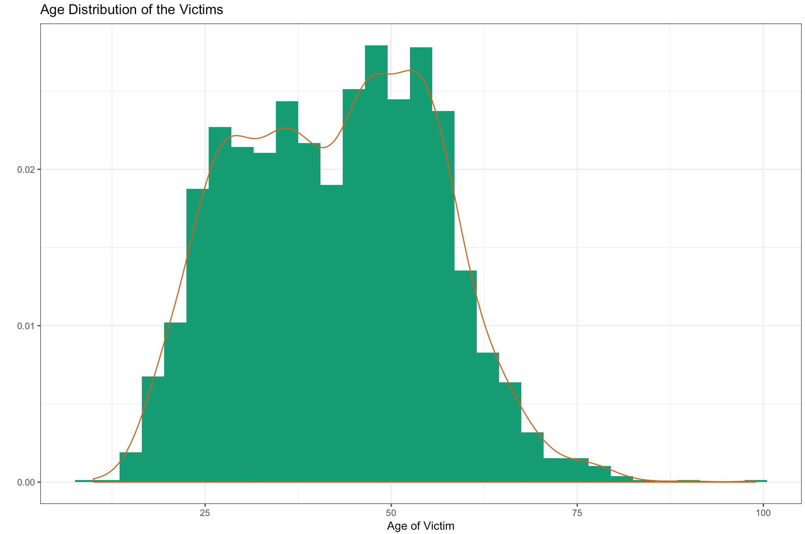
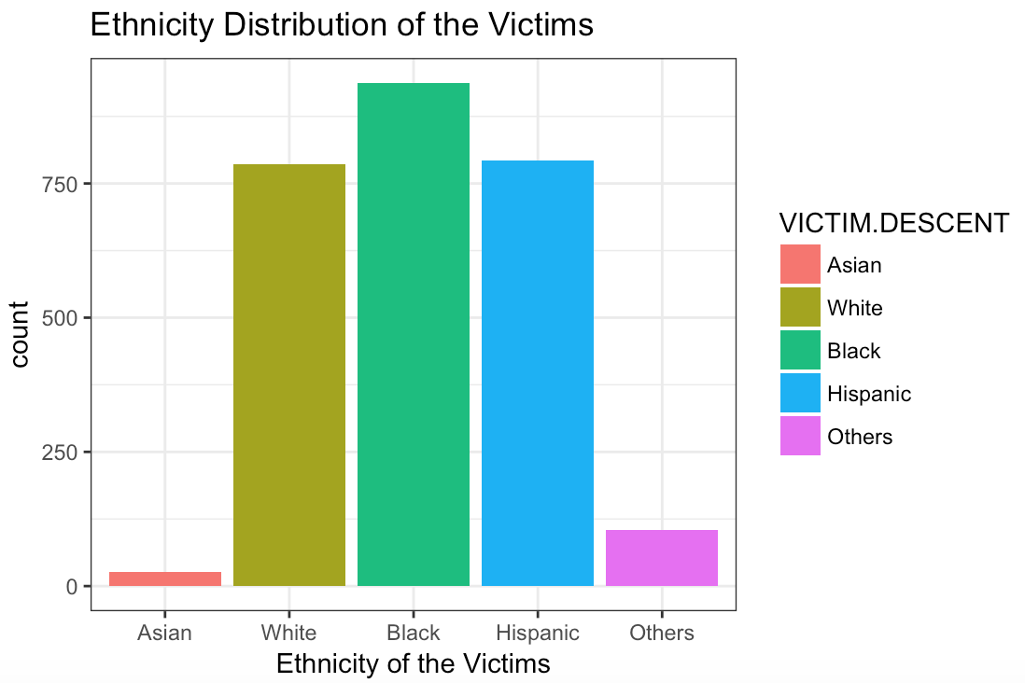
Demogrpahics of Victims
The majority of victims aged 25-60
Female > Male
Black, White, and Hispanic
Notes:
Then we looked into the demographic features of the victim. We found that

Slide 7
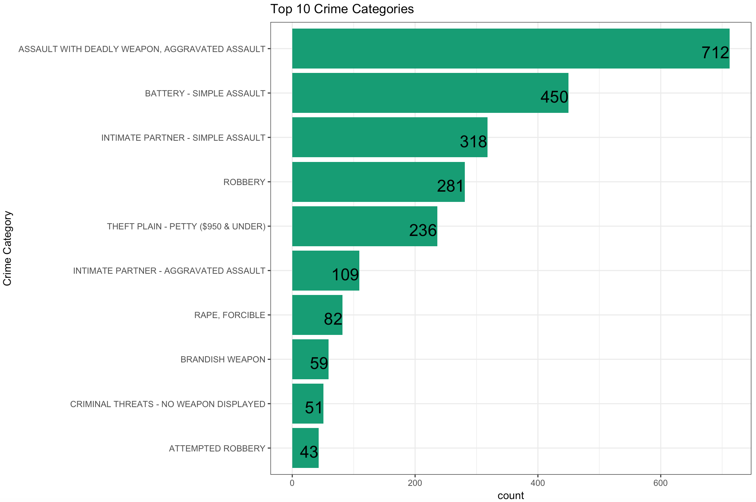
Top 10 Crime Categories
Assault (aggravated/simple)
Robbery
Theft

Slide 8
Part 2-Shelter Function

Slide 9
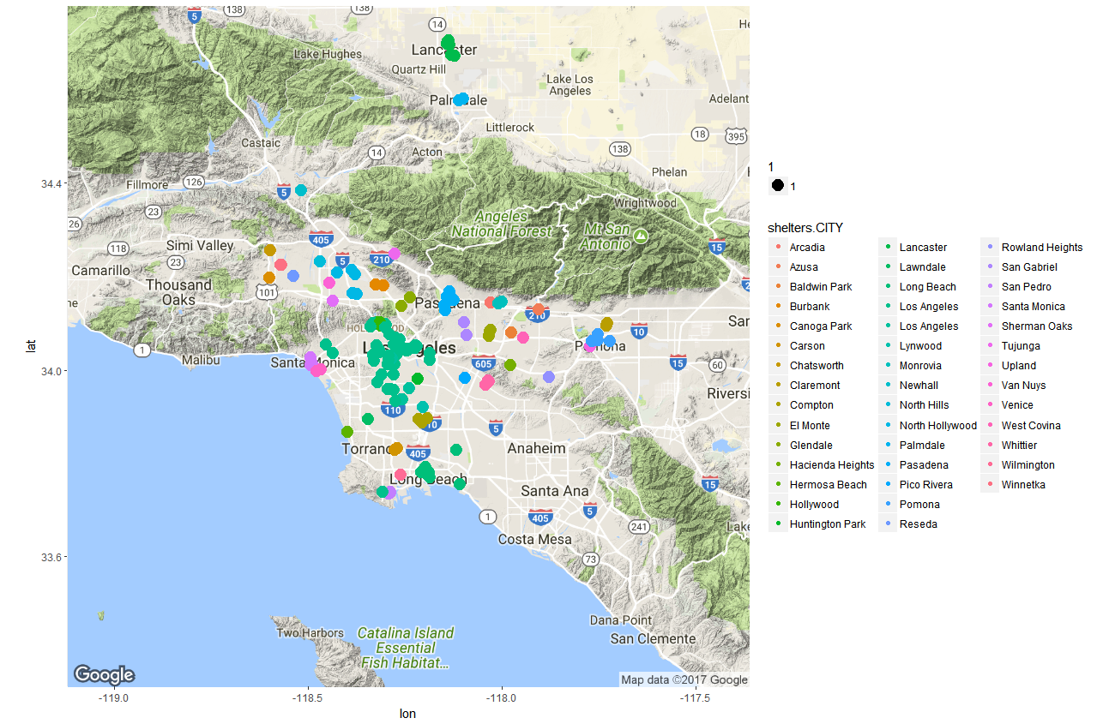
Shelters in LA
This image indicates the shelters seem evenly located in LA
Notes:
Thank you.
So far, I mainly do my research on Shelters dataset, and I used text analytics method on this dataset. Especially for the shelters description.
At first, let’s see this may, This is how shelters located in LA and we can simplify say that the shelters seem located evenly in LA. And maybe we could assume that homeless people may get help everywhere only if they are in LA

Slide 10
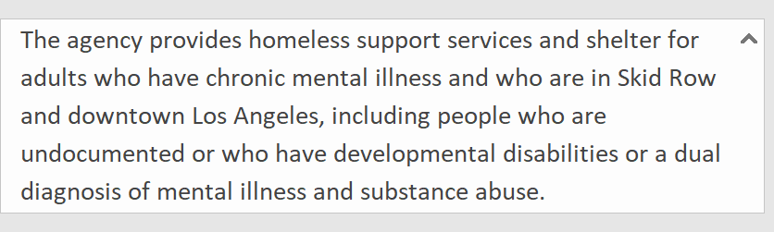
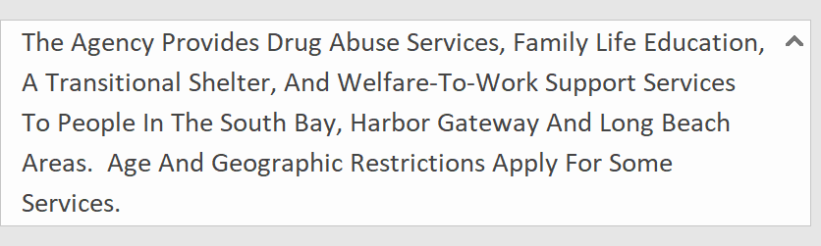
Shelters’ Description
Lamp Community - Frank Rice Access Center
Words in different descriptions are various a lot
There are several expressions to explain the same thing
Wecan House
Notes:
However, if we look at the shelters’ description, we find that different shelters actually provide not only limited, but different services. So it hard to say whether the shelters already provide enough necessary services.
And they sometimes used different expression to explain the same things.
For example, the upper one used substance abuse, and lower one used drug abuse.

Slide 11
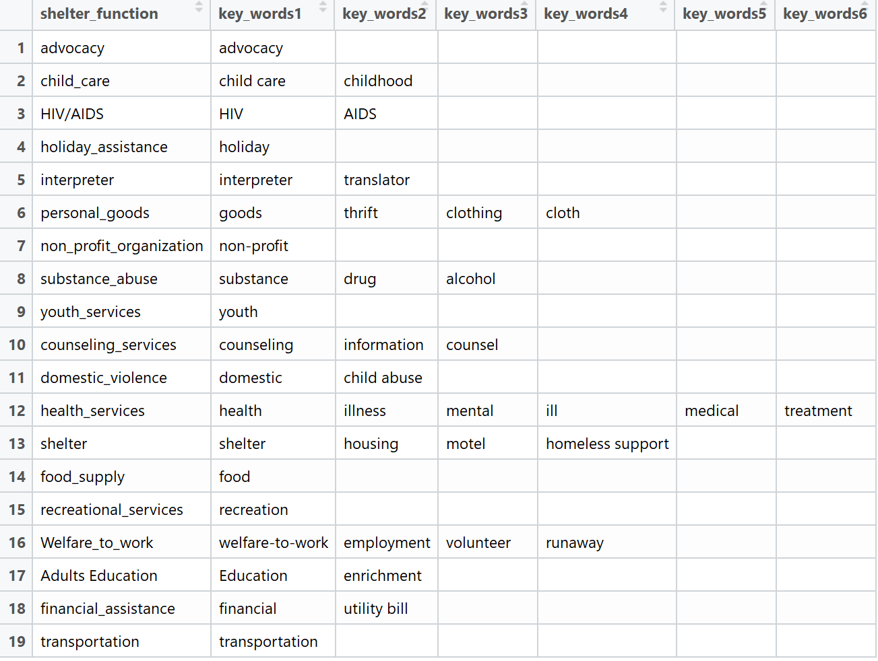
Services - Key words Dataset
A new dataset was created to identity the key words for different services
The shelter have been divided into 19 function and each function with 6 key words at most to identify.
Notes:
After detected all the description. I figured out nineteen functions that shelters could apply, They included child care, holiday assistance, substance abuse and so on.
Each function match several keywords to help us identify the function from the description.

Slide 12
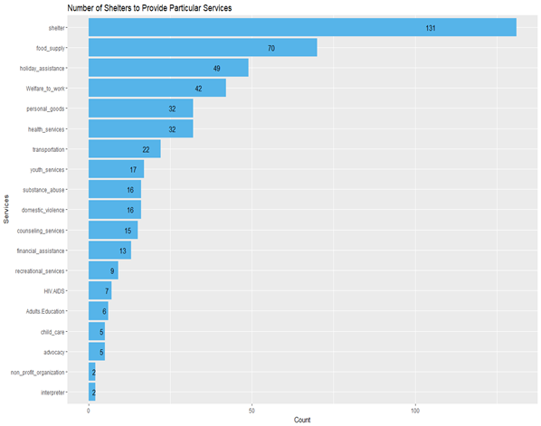
Number of Shelters to Provide Particular Services
The differential among the numbers is obvious
For example, there are 70 of the shelters with foot supply services but only 13 with financial assistance
Notes:
Here is the statistics for shelters by function
And here we can see that there are 131 shelters provide the shelter services, and 70 shelters provide emergency food.
However, there are only 13 shelters provide financial assistance and 6 have adults education program.
The differential is obvious.

Slide 13
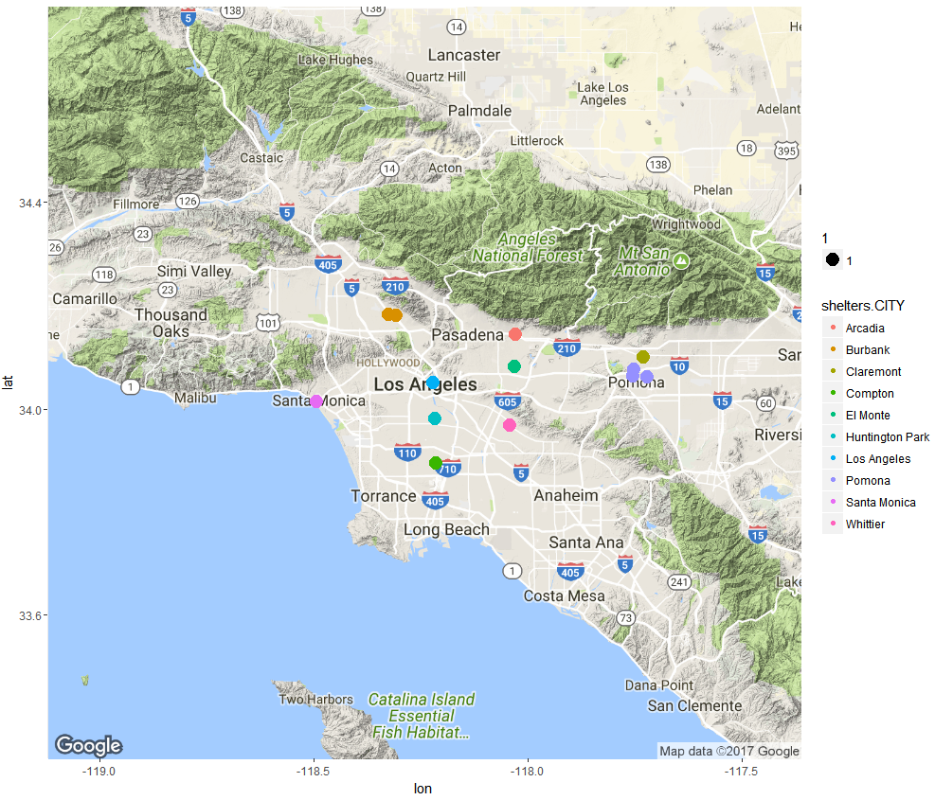
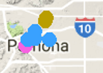
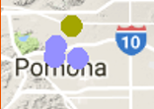
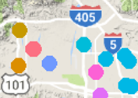
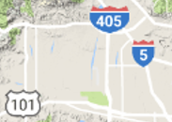
Shelters with Financial Assistance Service in LA
Two compared images come from the previous image “Shelters Distribution in LA”
Some district have several shelters to provide financial assistance while some district have none
Shelters
with financial assistance
All Shelters
Notes:
Ok, let’s see this map. This the map contains all shelters with financial assistance service, and let’s see these two particular area, the Pomona area, there are 4 shelters provide this service but another area, the number is zero,
And if we compare it with the previous map, and we can see there are only 6 shelters in Pomona area and there are, I don’t, a lot of shelters in that area. . But none of them provide financial assistance.
Here is the problem， of cause we cannot drew out conclusion so far but, we may see that our recourses were not distributed vary well. To build a brand new shelters is expensive but what if we can move the function from one area to another.
This is only one function with problem and we have another 18 function we need to consider in further. Besides, there are also some restriction for shelters and I think I will do more research on these.

Slide 14
Part 3 - 311 calls

Slide 15
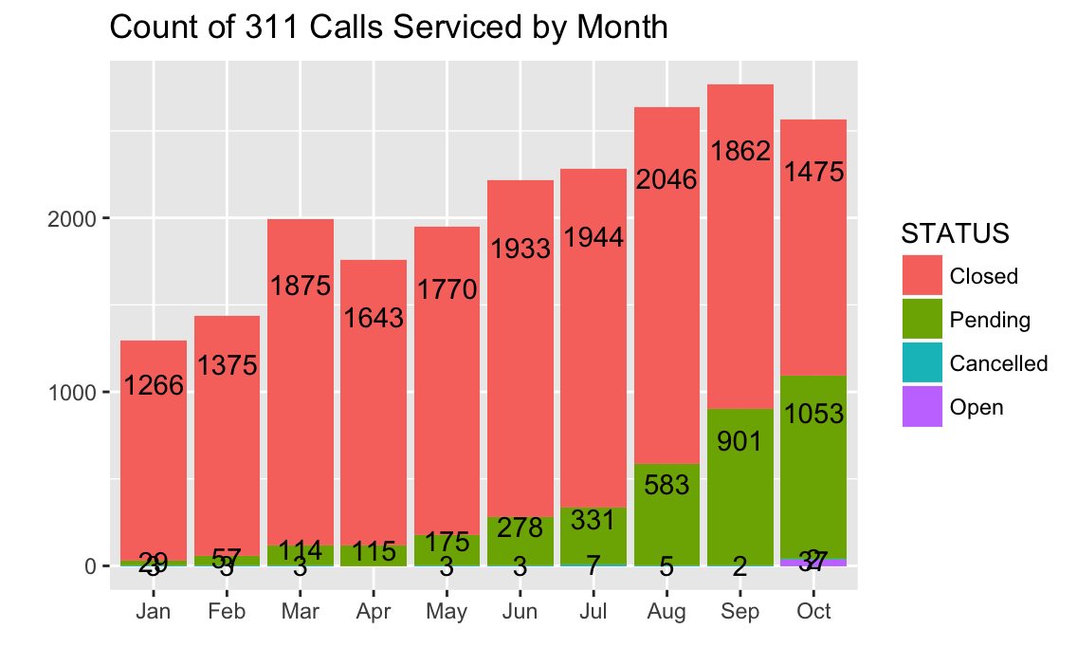
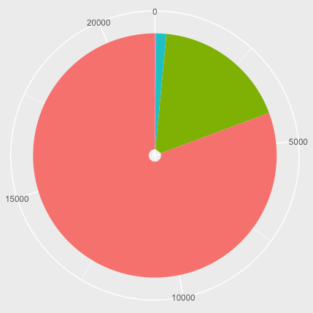
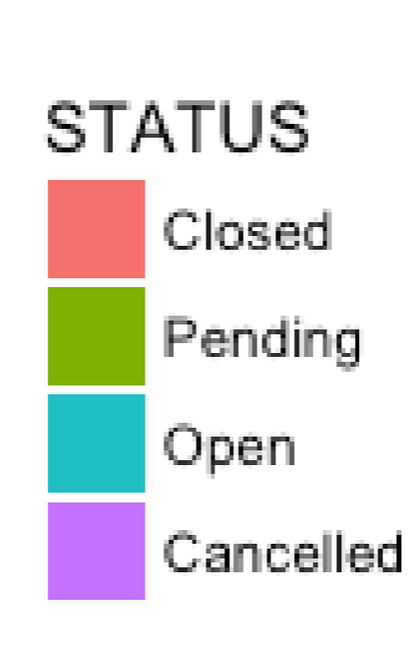
Growing monthly requests
Count of 311 Calls
by Month and Status
Stable service capability
Increasing pending cases (20%)
Status: Open/Pending/
with Service Date?
Closed
Pending Open Cancelled
Notes:
The ablibity to close a request, dropped
Requests grouped by created date or service date?

Slide 16
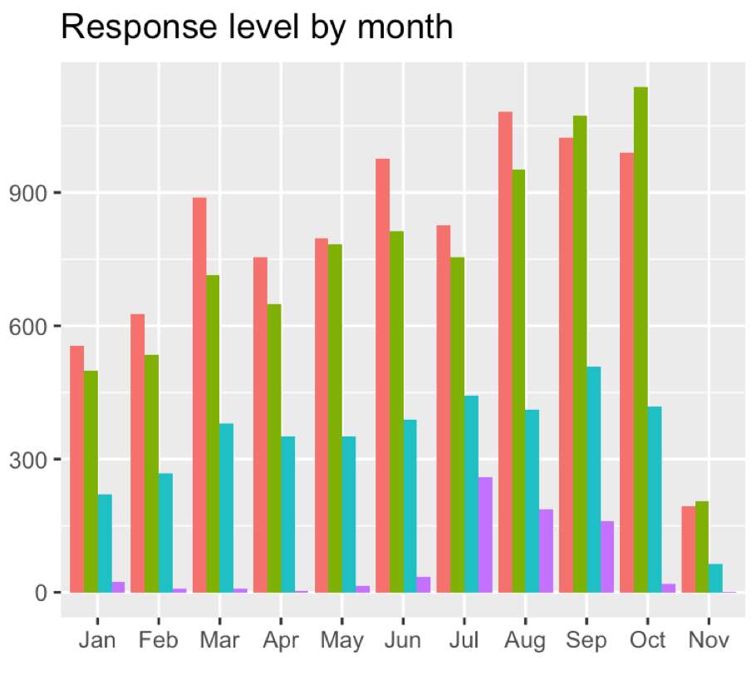
Increasing capacity to give quick response
Key Assumption : Response ~ days(service – created)
A glimpse at Response Period
Challenge to improve problem-solving ability
July? More efforts on long term awaiting call
Fast : 1-4
Medium: 5-7 Slow: 8-14 Ex-Slow: > 14
Notes:
The ability to give quick and medium response: improved
dim(data2[data2$RESPONSE_DAYS>30,])

Slide 17
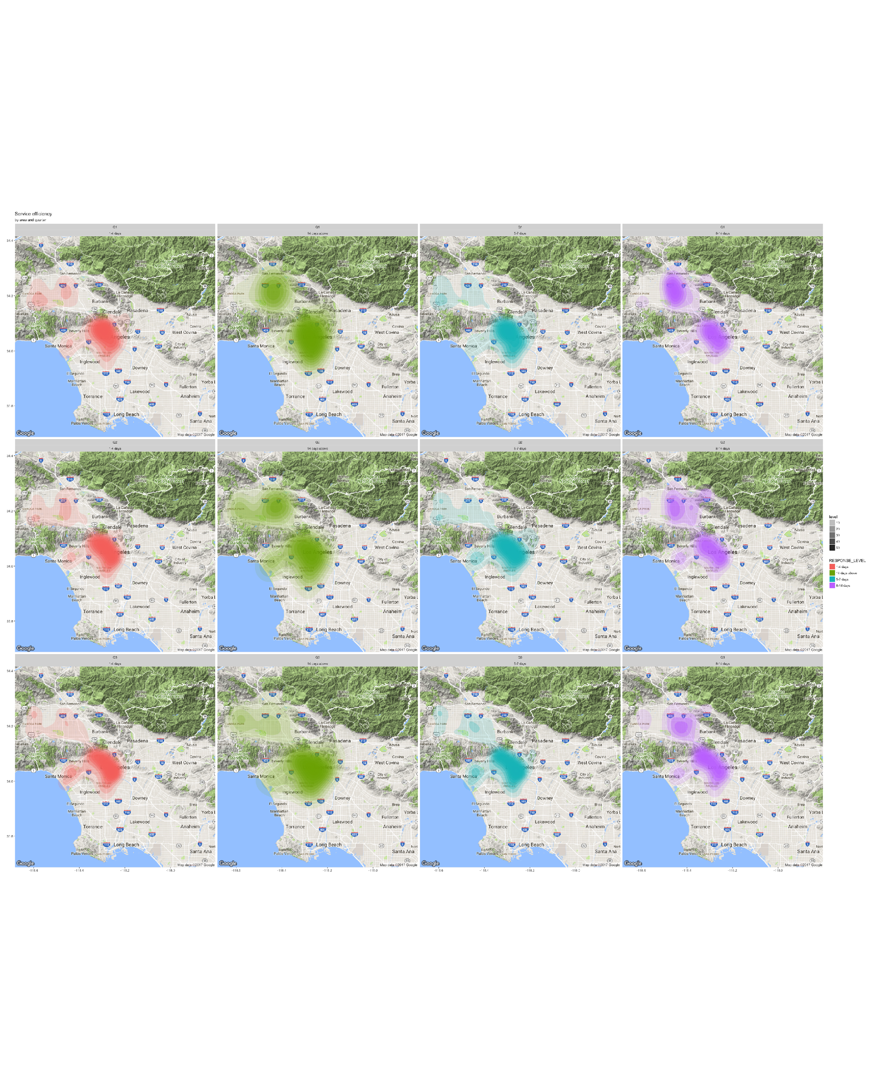
More north requests need more than 4 days to get response
Q1
Q2
Q3
A glimpse at Response Period
Requests from west more prioritized
Fast : 1-4
Medium: 5-7 Slow: 8-14 Ex-Slow: > 14

Slide 18
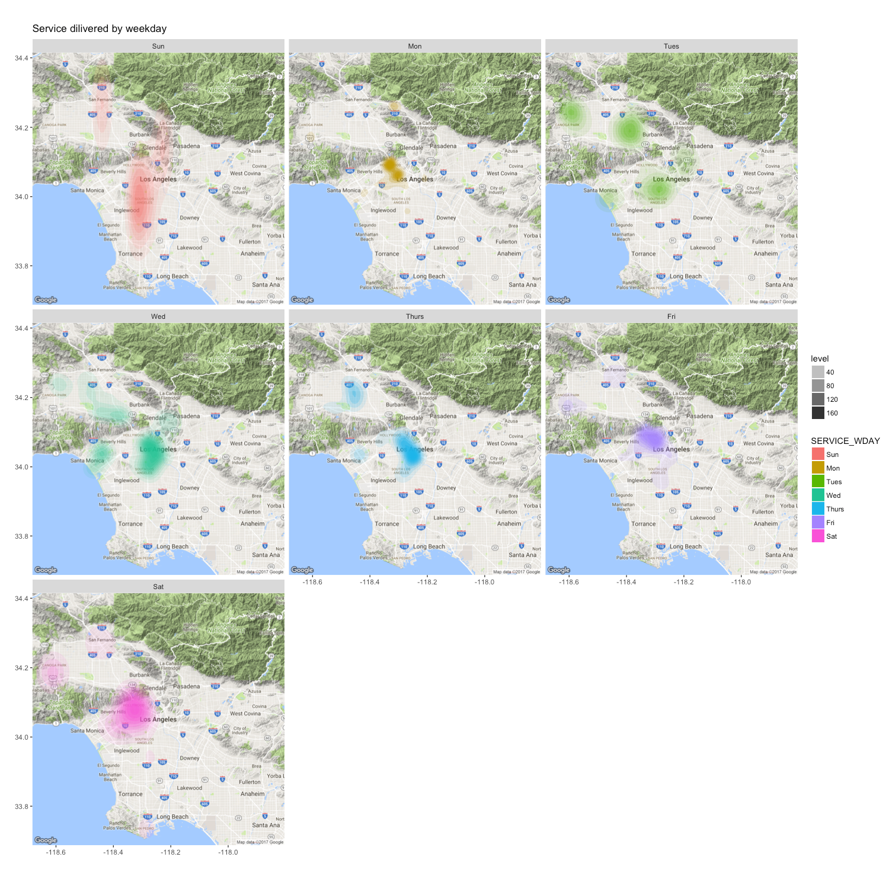
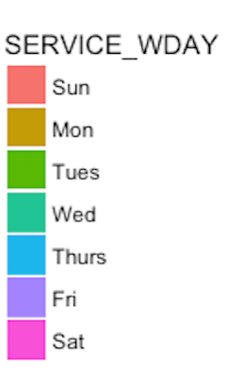
Tremendous work on Sunday
A glimpse at Response Period
Lazy work on Monday and Friday

Slide 19
NEXT STEP
To visualize our analysis on the service planning area (SPA) or county level. in this way we can make more administrative analysis and suggestions
To dig deeper into the data we have, and try to find the inner relationship between crimes, shelter distribution and functionality, like
To build our findings into a more interactive way, like Shiny
Geospatial visualization
Deeper analysis
Interactive application

Slide 20
Thank you !

